Slide 1
Spring Security

Slide 2
What is Spring Security?
Spring Security provides comprehensive security services for J2EE-based enterprise software applications.
People use Spring Security for many reasons, but most are drawn to the project after finding the security features of J2EE's Servlet Specification or EJB Specification lack the depth required for typical enterprise application scenarios. Therefore, if you switch server environments, it is typically a lot of work to reconfigure your application's security in the new target environment.
Using Spring Security overcomes these problems, and also brings you dozens of other useful, customisable security features.
“Authentication” and “authorization” are the two main areas that Spring Security targets.

Slide 3
Hystory
Spring Security began in late 2003 as “The Acegi Security System for Spring”.
With that in mind, a simple security implementation was built and not released. A few weeks later another member of the Spring community inquired about security, and at the time this code was offered to them. Several other requests followed, and by January 2004 around twenty people were using the code. These pioneering users were joined by others who suggested a SourceForge project was in order, which was duly established in March 2004.
In those early days, the project didn't have any of its own authentication modules. Container Managed Security was relied upon for the authentication process, with Acegi Security instead focusing on authorization. This was suitable at first, but as more and more users requested additional container support, the fundamental limitation of container-specific authentication realm interfaces became clear. There was also a related issue of adding new JARs to the container's classpath, which was a common source of end user confusion and misconfiguration.
Acegi Security-specific authentication services were subsequently introduced. Around a year later, Acegi Security became an official Spring Framework subproject. The 1.0.0 final release was published in May 2006 - after more than two and a half years of active use in numerous production software projects and many hundreds of improvements and community contributions.
Acegi Security became an official Spring Portfolio project towards the end of 2007 and was rebranded as “Spring Security”.
Today Spring Security enjoys a strong and active open source community. There are thousands of messages about Spring Security on the support forums. There is an active core of developers who work on the code itself and an active community which also regularly share patches and support their peers.

Slide 4
Hello world!

Slide 5
Include dependency into pom.xml
<!-- Spring Security -->
<dependency>
<groupId>org.springframework.security</groupId>
<artifactId>spring-security-core</artifactId>
<version>3.1.0.RELEASE</version>
</dependency>
<dependency>
<groupId>org.springframework.security</groupId>
<artifactId>spring-security-web</artifactId>
<version>3.1.0.RELEASE</version>
</dependency>
<dependency>
<groupId>org.springframework.security</groupId>
<artifactId>spring-security-config</artifactId>
<version>3.1.0.RELEASE</version>
</dependency>

Slide 6
Change Web.xml
<context-param>
<param-name>contextConfigLocation</param-name>
<param-value>
/WEB-INF/spring/root-context.xml
/WEB-INF/spring/application-security.xml
</param-value>
</context-param>
…
<filter>
<filter-name>springSecurityFilterChain</filter-name>
<filter-class>org.springframework.web.filter.DelegatingFilterProxy</filter-class>
</filter>
<filter-mapping>
<filter-name>springSecurityFilterChain</filter-name>
<url-pattern>/*</url-pattern>
</filter-mapping>

Slide 7
Create application-security.xml
XML header
<?xml version="1.0" encoding="UTF-8"?>
<beans:beans xmlns="http://www.springframework.org/schema/security"
xmlns:beans="http://www.springframework.org/schema/beans" xmlns:xsi="http://www.w3.org/2001/XMLSchema-instance"
xsi:schemaLocation="http://www.springframework.org/schema/beans
http://www.springframework.org/schema/beans/spring-beans-3.0.xsd
http://www.springframework.org/schema/security
http://www.springframework.org/schema/security/spring-security-3.1.xsd">

Slide 8
Create application-security.xml
XML body
<http pattern="/css/**" security="none" />
<http auto-config="true">
<intercept-url pattern="/secure/**" access="ROLE_USER" />
<intercept-url pattern="/admin/**" access="ROLE_ADMIN" />
</http>
<authentication-manager>
<authentication-provider>
<user-service>
<user name="admin" password="adminpassword" authorities="ROLE_USER, ROLE_ADMIN" />
<user name="user" password="userpassword" authorities="ROLE_USER" />
</user-service>
</authentication-provider>
</authentication-manager>
</beans:beans>

Slide 9
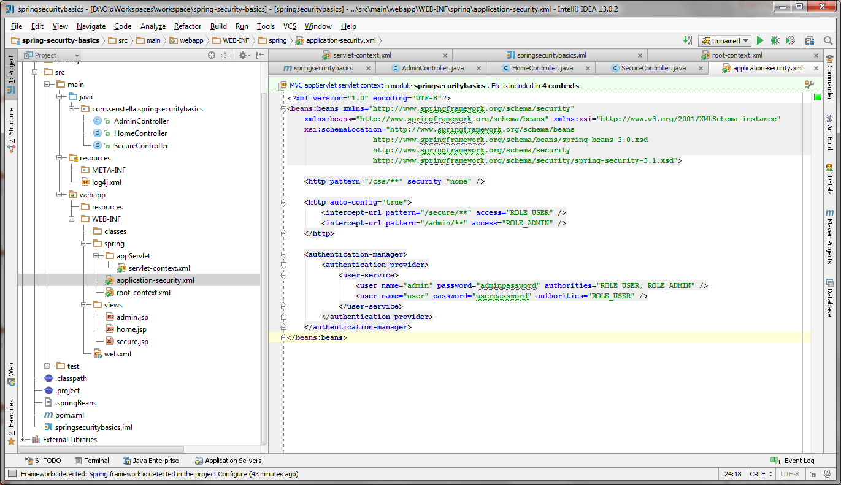
Project structure

Slide 10
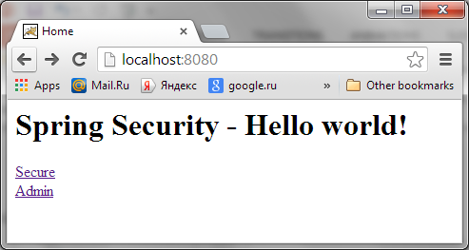
Title page

Slide 11
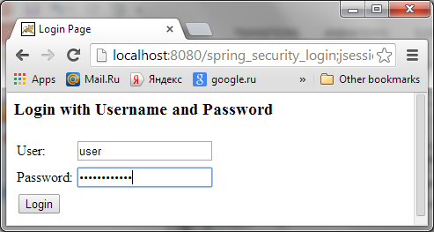
Login page

Slide 12
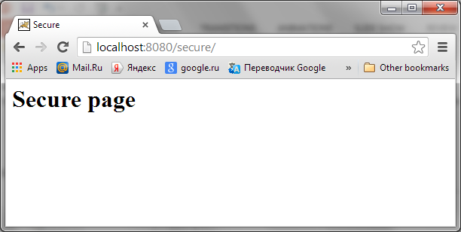
Secure page

Slide 13
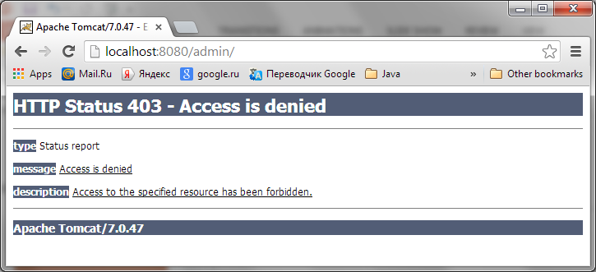
Admin page

Slide 14
Login page

Slide 15
What does auto-config Include?
The auto-config attribute, as we have used it above, is just a shorthand syntax for:
<http>
<form-login />
<http-basic />
<logout />
</http>
You might be wondering where the login form came from when you were prompted to log in, since we made no mention of any HTML files or JSPs. In fact, since we didn't explicitly set a URL for the login page, Spring Security generates one automatically, based on the features that are enabled and using standard values for the URL which processes the submitted login, the default target URL the user will be sent to after loggin in and so on.

Slide 16
Changes in application-security.xml
<http auto-config="true">
<intercept-url pattern="/secure/**" access="ROLE_USER" />
<intercept-url pattern="/admin/**" access="ROLE_ADMIN" />
<intercept-url pattern="/login" access="IS_AUTHENTICATED_ANONYMOUSLY" />
<form-login login-page="/signin"
authentication-failure-url="/signin-failure" default-target-url="/" />
</http>
<authentication-manager>
<authentication-provider user-service-ref="customUserDetailsService">
</authentication-provider>
</authentication-manager>

Slide 17
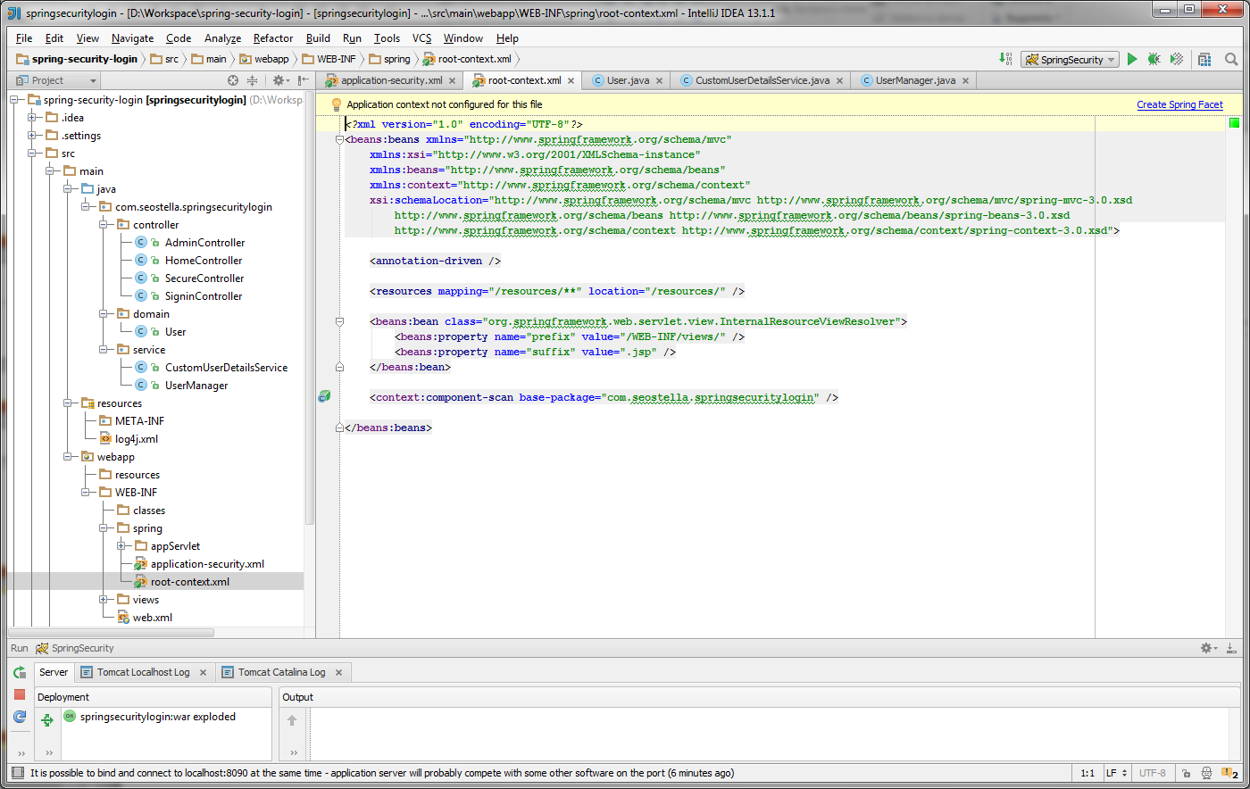
Structure of project

Slide 18
CustomUserDetailsService
@Service
public class CustomUserDetailsService implements UserDetailsService{
@Autowired
private UserManager userManager;
public UserDetails loadUserByUsername(String username)
throws UsernameNotFoundException {
return userManager.getUser(username);
}
}

Slide 19
Class UserMahager
@Service
public class UserManager {
private HashMap<String, User> users;
public UserManager() {
users = new HashMap<String, User>();
users.put("john", new User("john", "1", "ROLE_USER"));
users.put("bob", new User("bob", "2", "ROLE_USER, ROLE_ADMIN"));
}
public User getUser(String username) throws UsernameNotFoundException{
if( !users.containsKey( username ) ){
throw new UsernameNotFoundException( username + " not found" );
}
return users.get( username );
}
}

Slide 20
Class User
public class User implements UserDetails {
private static final long serialVersionUID = 8266525488057072269L;
private String username;
private String password;
private Collection<GrantedAuthority> authorities;
public User(String username, String password, String roles) {
super();
this.username = username;
this.password = password;
this.setRoles(roles);
}

Slide 21
Class User. Method SetRoles
public void setRoles(String roles) {
this.authorities = new HashSet<GrantedAuthority>();
for (final String role : roles.split(",")) {
if (role != null && !"".equals(role.trim())) {
GrantedAuthority grandAuthority = new GrantedAuthority() {
private static final long serialVersionUID = 3958183417696804555L;
public String getAuthority() {
return role.trim();
}
};
this.authorities.add(grandAuthority);
}
}
}

Slide 22
Class User. Another methods
public void setUsername(String username) {this.username = username;}
public void setPassword(String password) {this.password = password;}
public Collection<? extends GrantedAuthority> getAuthorities() {return this.authorities;}
public String getPassword() {return password;}
public String getUsername() { return username;}
public boolean isAccountNonExpired() {return true;}
public boolean isAccountNonLocked() { return true;}
public boolean isCredentialsNonExpired() { return true;}
public boolean isEnabled() {return true;}

Slide 23
SigninController
@Controller
public class SigninController {
@RequestMapping(value = "/signin", method = RequestMethod.GET)
public String signin() {
return "user/signin";
}
@RequestMapping(value = "/signin-failure", method = RequestMethod.GET)
public String signinFailure() {
return "user/signin_failure";
}

Slide 24
Signin.jsp
<%@ taglib uri="http://java.sun.com/jsp/jstl/core" prefix="c"%>
<%@ taglib uri="http://www.springframework.org/tags/form" prefix="form"%>
<%@ taglib uri="http://www.springframework.org/tags" prefix="spring"%>
<%@ page session="true"%>
<html>
<head>
<title>Sign In</title>
</head>
<body>
<h1>Spring Security - Sign In</h1>
<div style="color: red">${message}</div>
<form class="login-form" action="j_spring_security_check" method="post">
<label for="j_username">Username: </label>
<input id="j_username" name="j_username" size="20" maxlength="50" type="text" />
<label for="j_password">Password: </label>
<input id="j_password" name="j_password" size="20" maxlength="50" type="password" />
<input type="submit" value="Login" />
</form>
</body>
</html>

Slide 25
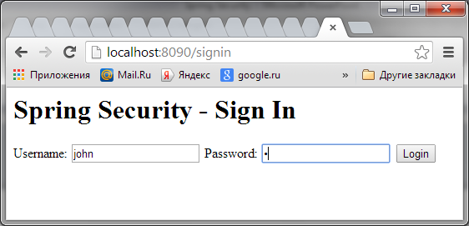
Custom login form

Slide 26
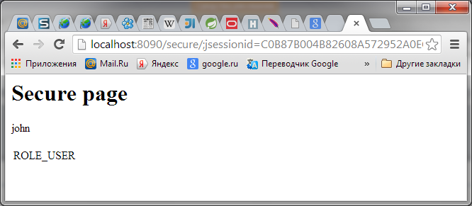
Secure page

Slide 27
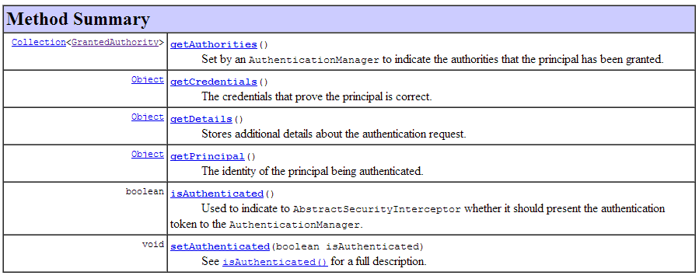
Interface Authentication
User user = (User)SecurityContextHolder.getContext().getAuthentication().getPrincipal();

Slide 28
Customize HTTP 403 Access Denied Page
The easiest way is uses “access-denied-handler‘ tag, and put your 403 page in “error-page” attribute:
<http auto-config="true">
<intercept-url pattern="/admin*" access="ROLE_ADMIN" />
<access-denied-handler error-page=“/accessDenied"/>
</http>

Slide 29
AccessDeniedHandler
public class MyAccessDeniedHandler implements AccessDeniedHandler {
private String accessDeniedUrl;
public MyAccessDeniedHandler() {}
public MyAccessDeniedHandler(String accessDeniedUrl) {
this.accessDeniedUrl = accessDeniedUrl;
}
@Override
public void handle(HttpServletRequest request, HttpServletResponse response, AccessDeniedException accessDeniedException) throws IOException, ServletException {
response.sendRedirect(accessDeniedUrl);
request.getSession().setAttribute("message",
"You do not have permission to access this page!");
}
public String getAccessDeniedUrl() {return accessDeniedUrl;}
public void setAccessDeniedUrl(String accessDeniedUrl) {
this.accessDeniedUrl = accessDeniedUrl;
}
}

Slide 30
Changes in context and security configuration
<bean id="accessDeniedHandler"
class="com.common.handler.MyAccessDeniedHandler">
<property name="accessDeniedUrl" value="403" />
</bean>
<http auto-config="true">
<intercept-url pattern="/admin*" access="ROLE_ADMIN" />
<access-denied-handler ref="accessDeniedHandler"/>
</http>

Slide 31
Database Tables
CREATE TABLE `users` (
`USER_ID` INT(10) UNSIGNED NOT NULL,
`USERNAME` VARCHAR(45) NOT NULL,
`PASSWORD` VARCHAR(45) NOT NULL,
`ENABLED` tinyint(1) NOT NULL,
PRIMARY KEY (`USER_ID`)
) ENGINE=InnoDB DEFAULT CHARSET=utf8;
CREATE TABLE `user_roles` (
`USER_ROLE_ID` INT(10) UNSIGNED NOT NULL,
`USER_ID` INT(10) UNSIGNED NOT NULL,
`AUTHORITY` VARCHAR(45) NOT NULL,
PRIMARY KEY (`USER_ROLE_ID`),
KEY `FK_user_roles` (`USER_ID`),
CONSTRAINT `FK_user_roles` FOREIGN KEY (`USER_ID`) REFERENCES `users` (`USER_ID`)
) ENGINE=InnoDB DEFAULT CHARSET=utf8;
INSERT INTO users (USER_ID, USERNAME,PASSWORD, ENABLED) VALUES (100, ‘user1', '123456', TRUE);
INSERT INTO users (USER_ID, USERNAME,PASSWORD, ENABLED) VALUES (101, ‘user2', '654321', TRUE);
INSERT INTO user_roles (USER_ROLE_ID, USER_ID,AUTHORITY) VALUES (1, 100, 'ROLE_USER');
INSERT INTO user_roles (USER_ROLE_ID, USER_ID,AUTHORITY) VALUES (2, 100, 'ROLE_ADMIN');
INSERT INTO user_roles (USER_ROLE_ID, USER_ID,AUTHORITY) VALUES (1, 101, 'ROLE_USER');

Slide 32
Spring JDBC
<bean id="dataSource"
class="org.springframework.jdbc.datasource.DriverManagerDataSource">
<property name="driverClassName" value="com.mysql.jdbc.Driver" />
<property name="url" value="jdbc:mysql://localhost:3306/testSpringSecurity" />
<property name="username" value="root" />
<property name="password" value="password" />
</bean>

Slide 33
application-security.xml
<authentication-manager>
<authentication-provider>
<jdbc-user-service data-source-ref="dataSource"
users-by-username-query="
select username,password, enabled
from users where username=?"
authorities-by-username-query="
select u.username, ur.authority from users u, user_roles ur
where u.user_id = ur.user_id and u.username =? "
/>
</authentication-provider>
</authentication-manager>

Slide 34
Logout

Slide 35
j_spring_security_logout
In Spring Security, to log out, just add a link to url “j_spring_security_logout“, for example :
<%@ taglib prefix="c" uri="http://java.sun.com/jsp/jstl/core"%>
<html>
<body>
<h3>messages, whatever</h3>
<a href="<c:url value="j_spring_security_logout" />" > Logout</a>
</body>
</html>

Slide 36
j_spring_security_logout
You myght add dependency to pom.xml
<dependency>
<groupId>org.springframework.security</groupId>
<artifactId>spring-security-taglibs</artifactId>
<version>${org.springframework-version}</version>
</dependency>
Then you can use Spring security tags in the jsp
<sec:authorize access="isAuthenticated()">
<a href="<c:url value="/j_spring_security_logout"/>">Logout</a>
</sec:authorize>

Slide 37


